Slide 1
Popular Music Database
August 28, 2014

Slide 2
Executive Summary
System Requirements
ER Diagram
Normalized Relationship View
Normalization Analysis (3NF)
SQLite3 Implementation
Query Samples

Slide 3
System REquirements
The Popular Music Database provides a repository of data concerning music released during the 20th and 21st centuries. Users can access the database to receive information on artists, acts (either individuals performers or groups), albums, songs, and other related information.
In addition to its use as a research tool, the database could serve as a library for users to download songs and albums and create playlists through a Web-based front end.

Slide 4
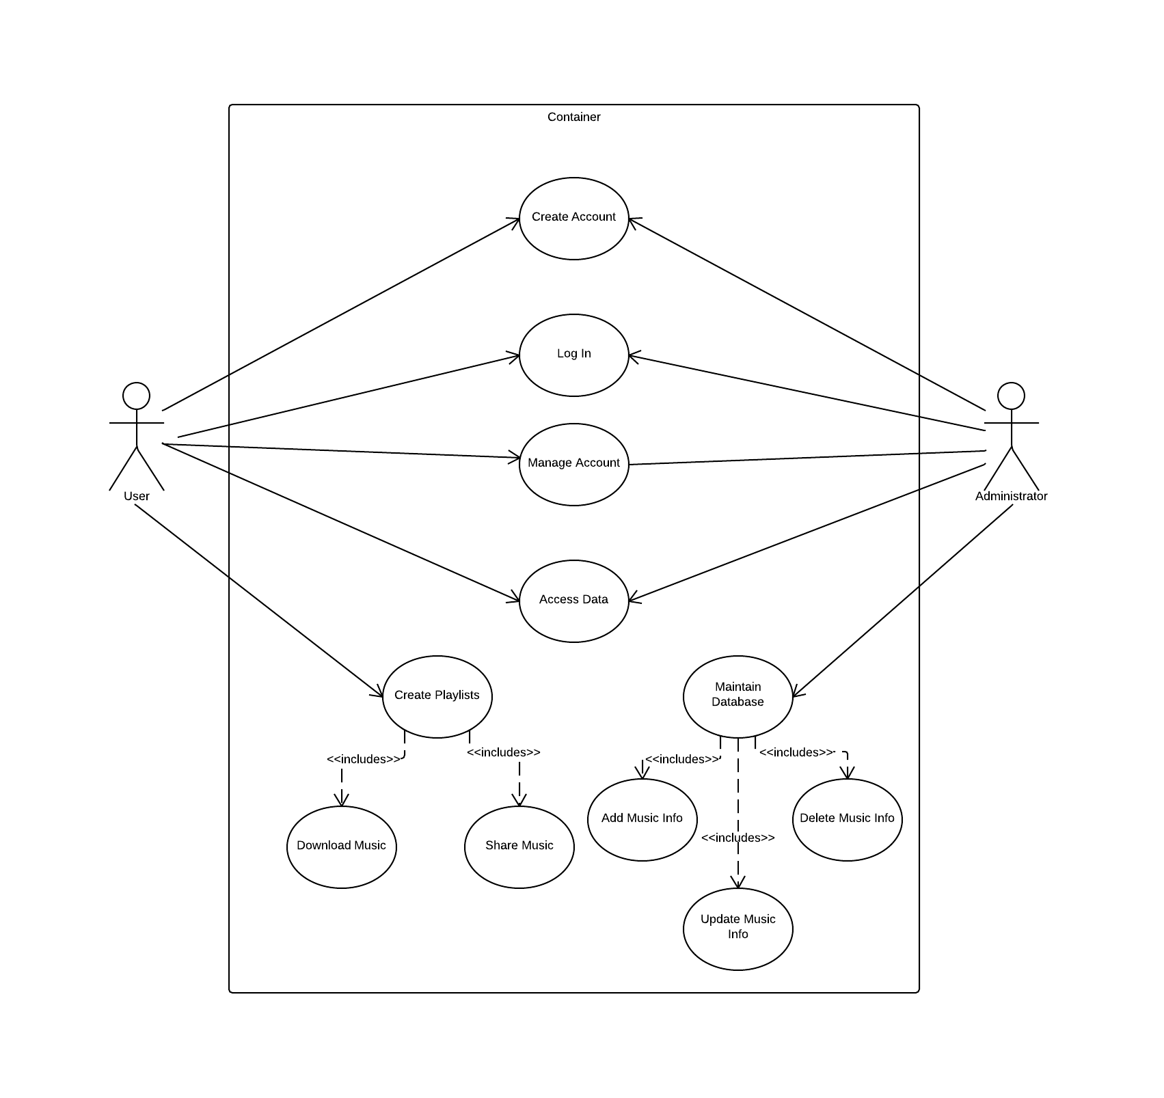
Use Case Diagram

Slide 5
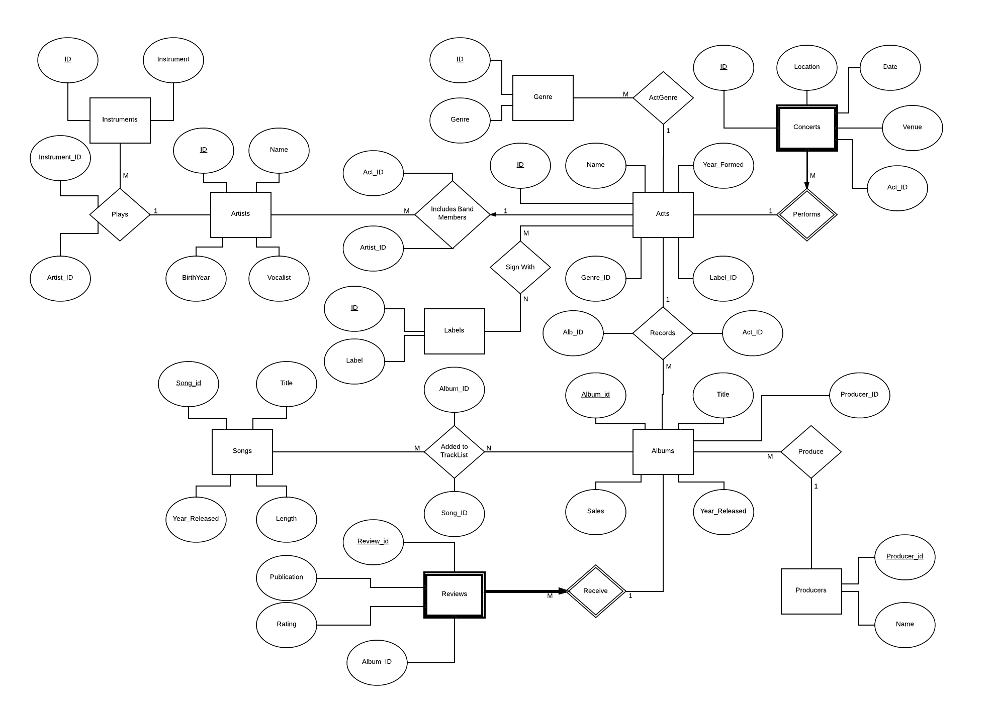
Entity-Relationship Diagram

Slide 6
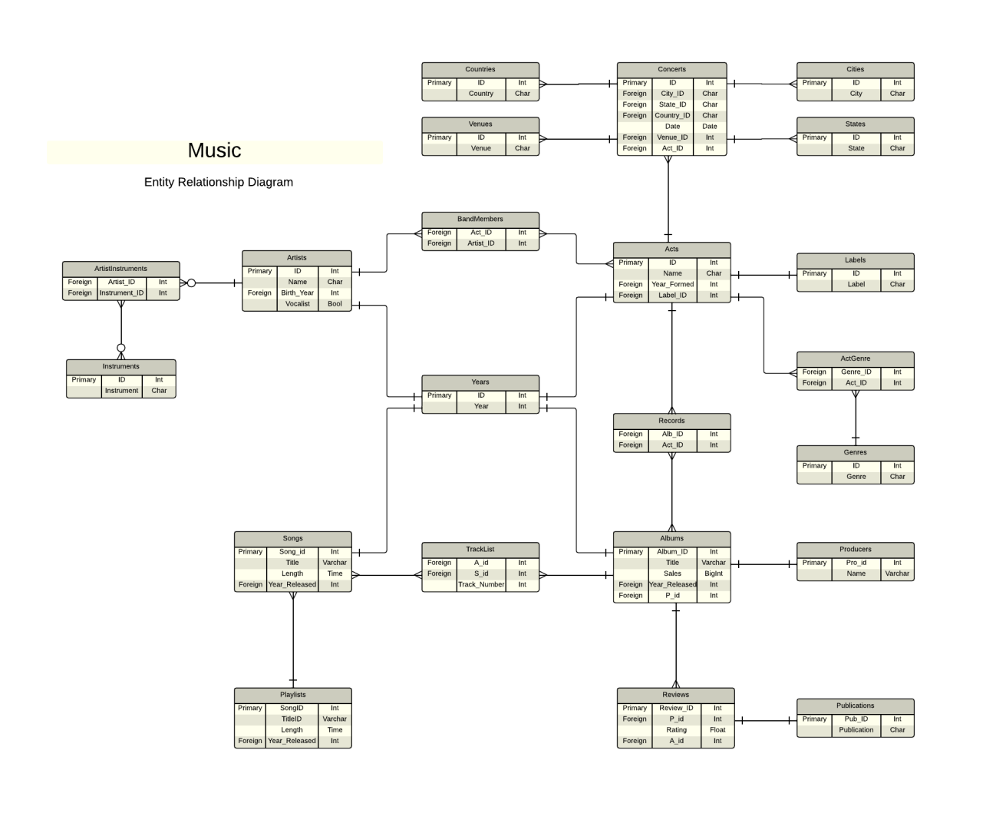
Normalized Relationship view

Slide 7
Normalization analysis (3NF)
Normalization of the entities and relationships include taking steps to ensure that the relational database satisfies the requirements of 1st, 2nd, and 3rd Normal Forms (1NF, 2NF, and 3NF).
In order to reach 3NF, we must first satisfy the requirements of 1NF and 2NF.
1NF is achieved by ensuring that the following conditions are met:
ADDLIST HERE

Slide 8
Schemas
CREATE TABLE Labels(
ID INTEGER PRIMARY KEY AUTOINCREMENT,
Label CHAR(25) NOT NULL UNIQUE
);
CREATE TABLE Genres(
ID INTEGER PRIMARY KEY AUTOINCREMENT,
Genre CHAR(25) NOT NULL UNIQUE
);
CREATE TABLE Cities(
ID INTEGER PRIMARY KEY AUTOINCREMENT,
City CHAR(25) NOT NULL UNIQUE
);
CREATE TABLE States(
ID INTEGER PRIMARY KEY AUTOINCREMENT,
State CHAR(25) NOT NULL UNIQUE
);

Slide 9
SCHEMAs (Cont.)
CREATE TABLE Countries(
ID INTEGER PRIMARY KEY AUTOINCREMENT,
Country CHAR(25) NOT NULL UNIQUE
);
CREATE TABLE Venues(
ID INTEGER PRIMARY KEY AUTOINCREMENT,
Venue CHAR(25) NOT NULL UNIQUE
);
CREATE TABLE Years(
ID INTEGER PRIMARY KEY AUTOINCREMENT,
Year INT NOT NULL UNIQUE check (Year > 1899 and Year < 2015)
);
CREATE TABLE Instruments(
ID INTEGER PRIMARY KEY AUTOINCREMENT,
Instrument CHAR(25) NOT NULL UNIQUE
);

Slide 10
SCHEMAs (Cont.)
CREATE TABLE Artists(
ID INTEGER PRIMARY KEY AUTOINCREMENT,
Name CHAR(25) NOT NULL,
Birth_Year INT NOT NULL,
Vocalist BOOLEAN NOT NULL,
FOREIGN KEY (Birth_Year) REFERENCES Years(ID)
);
CREATE TABLE ArtistInstruments(
Artist_ID INT NOT NULL,
Instrument_ID INT NOT NULL,
FOREIGN KEY (Artist_ID) REFERENCES Artists(ID),
FOREIGN KEY (Instrument_ID) REFERENCES Instruments(ID)
);

Slide 11
SCHEMAs (Cont.)
CREATE TABLE Acts(
ID INTEGER PRIMARY KEY AUTOINCREMENT,
Name CHAR(25) NOT NULL,
Year_Formed INT NOT NULL,
Label_ID INT NOT NULL,
FOREIGN KEY (Year_Formed) REFERENCES Years(ID)
FOREIGN KEY (Label_ID) REFERENCES Labels(ID)
);
CREATE TABLE ActGenre(
Genre_ID INT NOT NULL,
Act_ID INT NOT NULL,
FOREIGN KEY (Genre_ID) REFERENCES Genres(ID),
FOREIGN KEY (Act_ID) REFERENCES Acts(ID)
);

Slide 12
SCHEMAs (Cont.)
CREATE TABLE Concerts(
ID INTEGER PRIMARY KEY AUTOINCREMENT,
City_ID CHAR(25) NOT NULL,
State_ID CHAR(25) DEFAULT 13,
Country_ID CHAR(25) NOT NULL,
Date Date NOT NULL,
Venue_ID INT NOT NULL,
Act_ID INT NOT NULL,
FOREIGN KEY (City_ID) REFERENCES Cities(ID)
FOREIGN KEY (State_ID) REFERENCES States(ID)
FOREIGN KEY (Country_ID) REFERENCES Countries(ID)
FOREIGN KEY (Venue_ID) REFERENCES Venues(ID)
FOREIGN KEY (Act_ID) REFERENCES Acts(ID)
);
CREATE TABLE BandMembers(
Act_ID INT NOT NULL,
Artist_ID INT NOT NULL,
FOREIGN KEY (Act_ID) REFERENCES Acts(ID),
FOREIGN KEY (Artist_ID) REFERENCES Artists(ID)
);

Slide 13
SCHEMAs (Cont.)
CREATE TABLE Songs(
Song_id INTEGER PRIMARY KEY AUTOINCREMENT,
Title VARCHAR (64) NOT NULL,
Length TIME NOT NULL,
Year_Released INT NOT NULL,
FOREIGN KEY (Year_Released) REFERENCES Years (ID)
);
CREATE TABLE Albums (
Album_id INTEGER PRIMARY KEY AUTOINCREMENT,
Title VARCHAR (64) NOT NULL,
Sales BIGINT NOT NULL check (Sales > 0),
Year_Released INT NOT NULL,
P_id INT NOT NULL,
FOREIGN KEY (Year_Released) REFERENCES Years (ID),
FOREIGN KEY (P_id) REFERENCES Producers (Pro_id)
);
CREATE TABLE TrackList (
A_id INT NOT NULL,
S_id INT NOT NULL,
Track_Number INT check (Track_Number > 0),
FOREIGN KEY (A_id) REFERENCES Albums (Album_id) ON UPDATE CASCADE,
FOREIGN KEY (S_id) REFERENCES Songs (Song_id) ON DELETE CASCADE
);

Slide 14
SCHEMAs (Cont.)
CREATE TABLE Publications (
Pub_ID INTEGER PRIMARY KEY AUTOINCREMENT,
Publication CHAR(25) NOT NULL UNIQUE
);
CREATE TABLE Reviews (
Review_id INTEGER PRIMARY KEY AUTOINCREMENT,
P_id INT,
Rating FLOAT NOT NULL check (Rating >= 0.0 and Rating <= 5.0),
A_id INT NOT NULL,
FOREIGN KEY (P_id) REFERENCES Publications(Pub_ID),
FOREIGN KEY (A_id) REFERENCES Albums(Album_id) ON UPDATE CASCADE
);
CREATE TABLE Producers (
Pro_id INTEGER PRIMARY KEY AUTOINCREMENT,
Name VARCHAR (64) NOT NULL
);

Slide 15
SCHEMAs (Cont.)
CREATE TABLE Records (
Alb_id INT NOT NULL,
Act_id INT NOT NULL,
FOREIGN KEY (Alb_id) REFERENCES Albums (Album_id) ON UPDATE CASCADE,
FOREIGN KEY (Act_id) REFERENCES Acts (ID)
);
CREATE TABLE Playlists (
SongID Int primary key references Songs(Song_ID) ON DELETE CASCADE,
TitleID VARCHAR (64),
Length TIME,
Year_Released INT,
FOREIGN KEY (Year_Released) REFERENCES Years (ID)
);

Slide 16
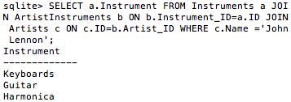
Queries - Instruments
SELECT a.Instrument FROM Instruments a JOIN ArtistInstruments b ON b.Instrument_ID=a.ID JOIN Artists c ON c.ID=b.Artist_ID WHERE c.Name ='John Lennon';

Slide 17
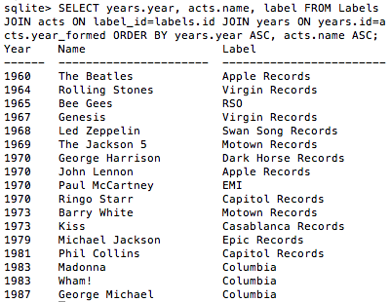
Queries - Labels
SELECT years.year, acts.name, label FROM Labels JOIN acts ON label_id=labels.id JOIN years ON years.id=acts.year_formed ORDER BY years.year ASC, acts.name ASC;

Slide 18
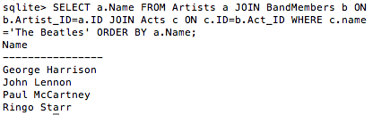
Queries - BandMembers
SELECT a.Name FROM Artists a JOIN BandMembers b ON b.Artist_ID=a.ID JOIN Acts c ON c.ID=b.Act_ID WHERE c.name ='The Beatles' ORDER BY a.Name;

Slide 19
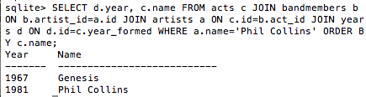
QUERIES – Artists acts
SELECT d.year, c.name FROM acts c JOIN bandmembers b ON b.artist_id=a.id JOIN artists a ON c.id=b.act_id JOIN years d ON d.id=c.year_formed WHERE a.name='Phil Collins' ORDER BY c.name;

Slide 20
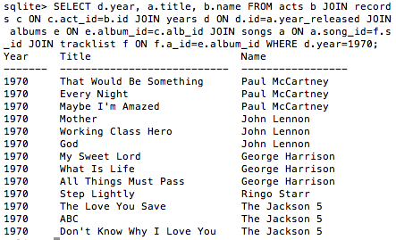
QUERIES – SONGS BY YEAR
SELECT d.year, a.title, b.name FROM acts b JOIN records c ON c.act_id=b.id JOIN years d ON d.id=a.year_released JOIN albums e ON e.album_id=c.alb_id JOIN songs a ON a.song_id=f.s_id JOIN tracklist f ON f.a_id=e.album_id WHERE d.year=1970;

Slide 21

QUERIES – Concerts dates
Select a.date, f.name, b.city, c.state, d.country, e.venue FROM Concerts a JOIN acts f ON f.ID=a.Act_ID JOIN Cities b ON b.ID=a.City_ID JOIN states c ON c.ID=a.state_id JOIN countries d ON d.id=a.country_id JOIN venues e ON e.id=a.venue_id WHERE a.date='1985-07-13';

Slide 22
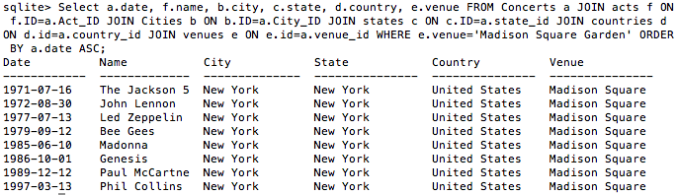
QUERIES – Concerts VENUES
Select a.date, f.name, b.city, c.state, d.country, e.venue FROM Concerts a JOIN acts f ON f.ID=a.Act_ID JOIN Cities b ON b.ID=a.City_ID JOIN states c ON c.ID=a.state_id JOIN countries d ON d.id=a.country_id JOIN venues e ON e.id=a.venue_id WHERE e.venue='Madison Square Garden' ORDER BY a.date ASC;

Slide 23
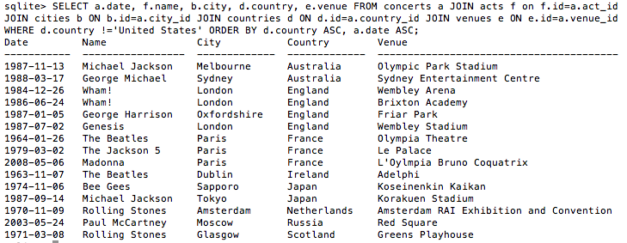
Queries – Concerts country
SELECT a.date, f.name, b.city, d.country, e.venue FROM concerts a JOIN acts f on f.id=a.act_id JOIN cities b ON b.id=a.city_id JOIN countries d ON d.id=a.country_id JOIN venues e ON e.id=a.venue_id WHERE d.country !='United States' ORDER BY d.country ASC, a.date ASC;

Slide 24
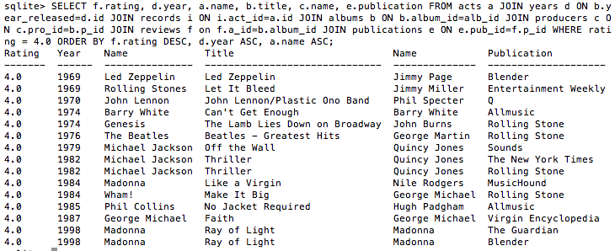
QUERIES - RATINGS
SELECT f.rating, d.year, a.name, b.title, c.name, e.publication FROM acts a JOIN years d ON b.year_released=d.id JOIN records i ON i.act_id=a.id JOIN albums b ON b.album_id=alb_id JOIN producers c ON c.pro_id=b.p_id JOIN reviews f on f.a_id=b.album_id JOIN publications e ON e.pub_id=f.p_id WHERE rating = 4.0 ORDER BY f.rating DESC, d.year ASC, a.name ASC;

Slide 25
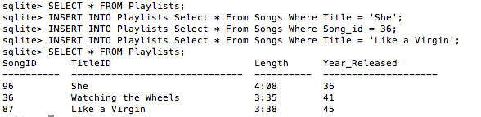
Cascade delete
INSERT INTO Playlists Select * From Songs Where Title = 'She';
INSERT INTO Playlists Select * From Songs Where Song_id = 36;
INSERT INTO Playlists Select * From Songs Where Title = 'Like a Virgin';
SELECT * FROM Playlists;

Slide 26
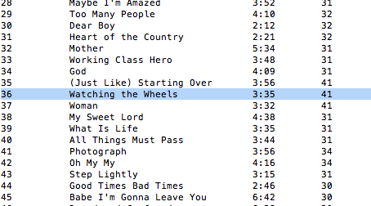
CASCADE DELETE (cont.)
SELECT * FROM Songs;

Slide 27
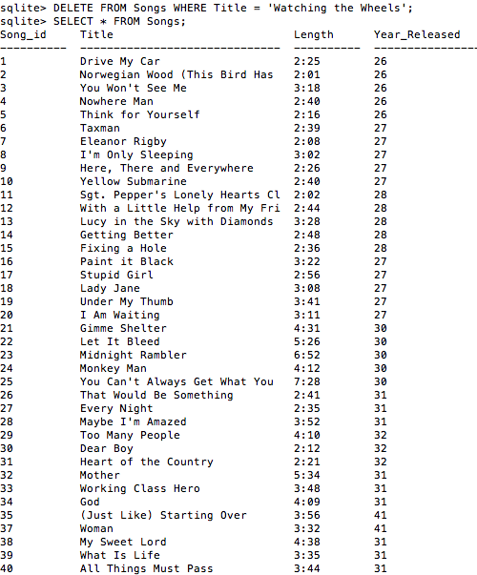
CASCADE DELETE (cont.)
DELETE FROM Songs WHERE Title = 'Watching the Wheels';
SELECT * FROM Songs;

Slide 28

CASCADE DELETE (cont.)
SELECT * FROM Playlists;

Slide 29
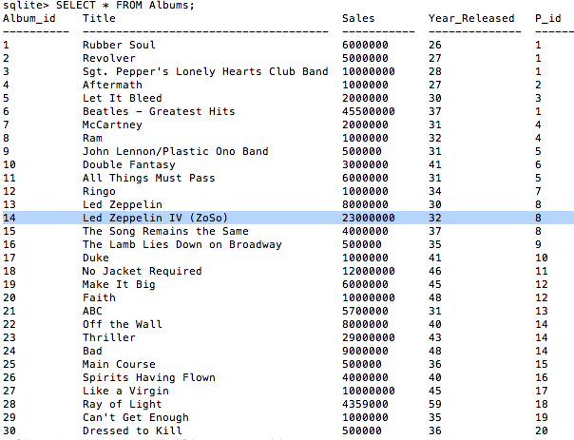
CASCADE UPDATE
SELECT * FROM Albums;

Slide 30
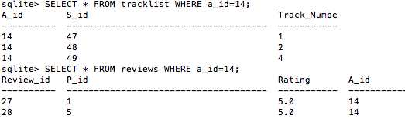
CASCADE UPDATE (Cont.)
SELECT * FROM tracklist WHERE a_id=14;
SELECT * FROM reviews WHERE a_id=14;

Slide 31
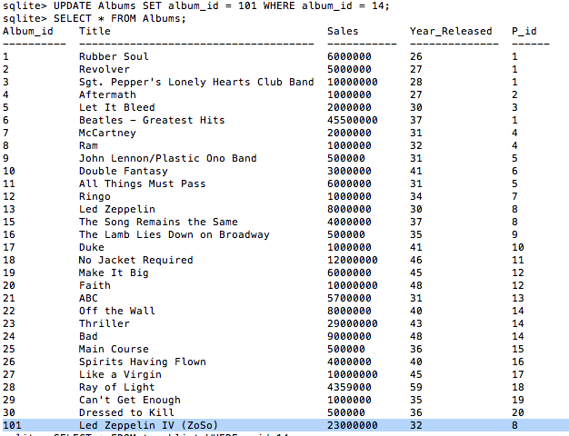
CASCADE UPDATE (Cont.)
UPDATE Albums SET album_id = 101 WHERE album_id = 14;
SELECT * FROM Albums;

Slide 32
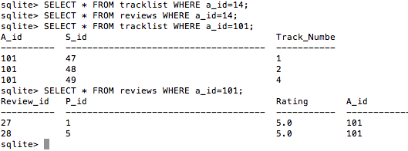
CASCADE UPDATE (Cont.)
SELECT * FROM tracklist WHERE a_id=14;
SELECT * FROM reviews WHERE a_id=14;
SELECT * FROM tracklist WHERE a_id=101;
SELECT * FROM reviews WHERE a_id=101;

Slide 33
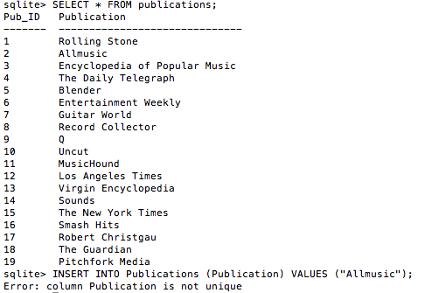
ERROR – Not Unique
INSERT INTO Publications (Publication) VALUES ("Allmusic");

Slide 34
ERROR – Constraint Failed
INSERT INTO Reviews (P_ID, Rating, A_id) VALUES(5,6,2);

